Slide 1
06/19

Slide 2
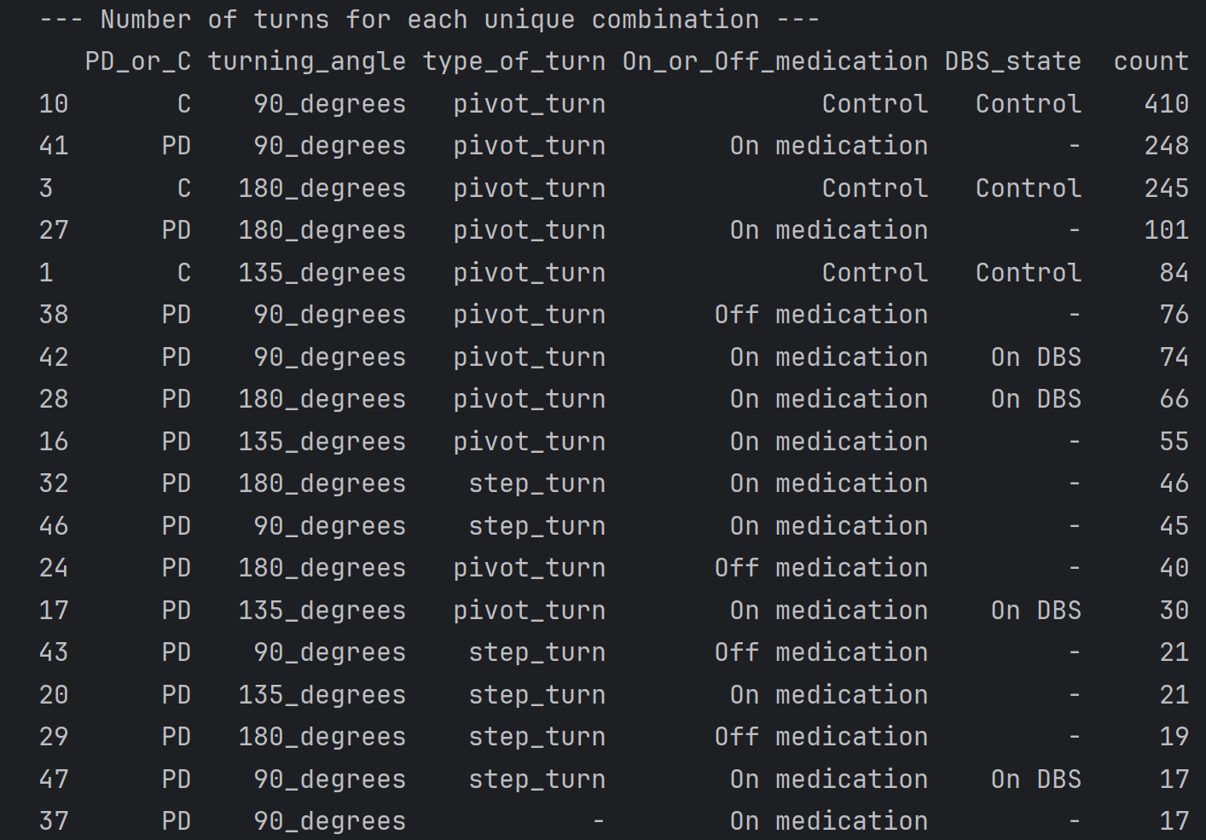
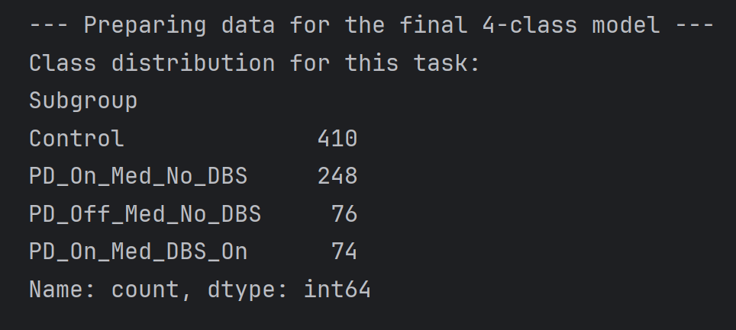

Subdata : 90 degree pivot turn
Data : we use 90_degree , pivot_turn dataset to build our model.

Slide 3
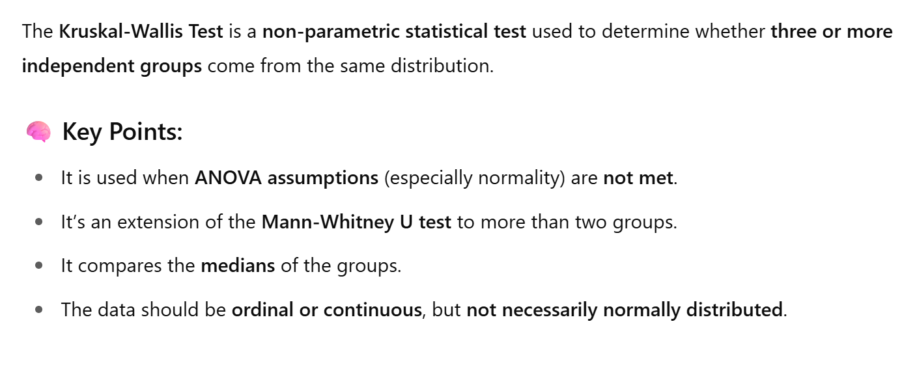
Kruskal-Wallis Test on 2D FEATURES
# Define the lists of features to test kinematic_features_2d = [ 'duration_sec', 'pelvis_path_length', 'pelvis_peak_speed', 'pelvis_avg_accel_mag', 'pelvis_avg_jerk_mag', 'trunk_total_rotation_deg', 'trunk_avg_ang_vel', 'trunk_peak_ang_vel' ]
We applied the Kruskal-Wallis test to assess whether there are statistically significant differences among the four subgroups in our dataset:

Slide 4
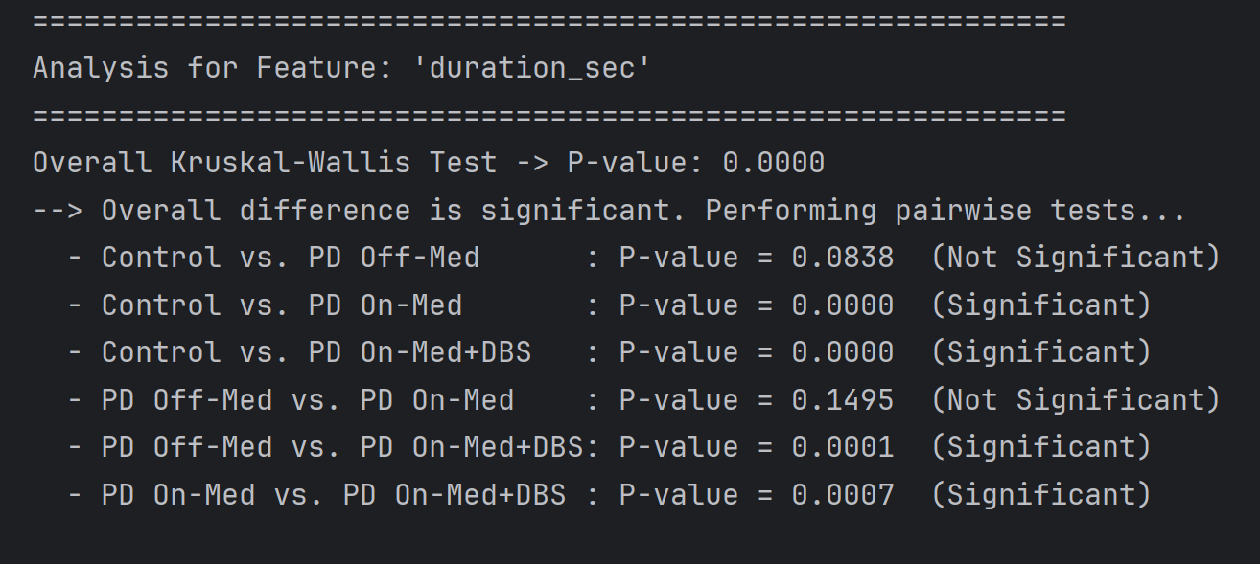
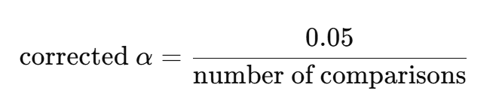
Statistically Significant Results : ‘duration_sec’
The overall p-value = 0.0000, indicating a significant difference exists between at least one pair of subgroups.
Since multiple pairwise comparisons were made (6 in total), we applied the Bonferroni correction to control for Type I error.
corrected_p_value = 0.05 / 6 = 0.0083
Only p-values below 0.0083 are considered statistically significant.
Bonferroni correction is a method used to reduce the chance of getting false positives (Type I errors) when performing multiple statistical tests. It does this by adjusting the significance level (α):
corrected α=0.05/number of comparisons.​ So if you run 6 pairwise tests, the new threshold becomes 0.0083 instead of 0.05. Only p-values below 0.0083 are considered statistically significant after correction.

Slide 5
Statistically Significant Results : ‘duration_sec’
Interpretation:
The Control group significantly differs from both PD On-Med and PD On-Med+DBS, suggesting task duration increases in PD patients under treatment.
PD Off-Med does not significantly differ from the Control group or PD On-Med, indicating high variability or milder symptoms in the Off-Med state.
Significant differences between PD subgroups (On-Med vs. DBS, Off-Med vs. DBS) suggest that DBS treatment may influence task performance duration.
duration_sec represents the time taken to complete a task

Slide 6
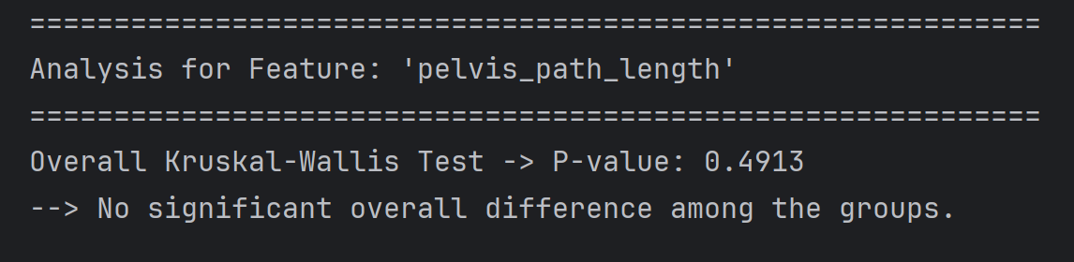
Statistically Significant Results: ‘pelvis_path_length’

Slide 7
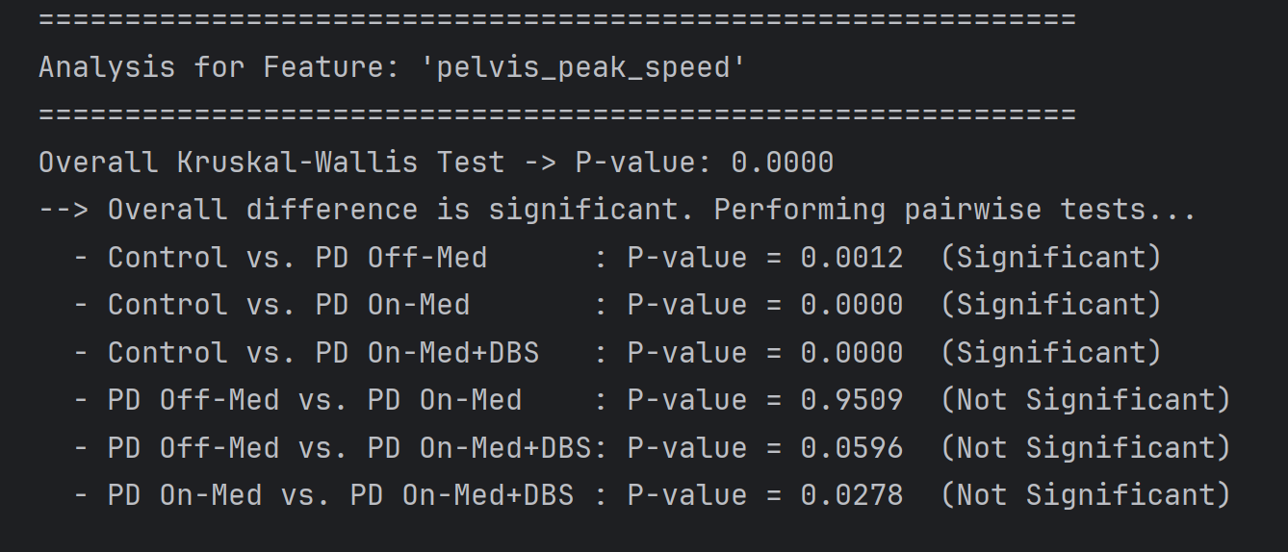
Statistically Significant Results: ‘pelvis_peak_speed’
Interpretation:
All comparisons involving the Control group showed significant differences in pelvis_peak_speed, suggesting this feature is useful in distinguishing Parkinson’s patients from healthy controls.
However, differences between Parkinson’s subgroups (e.g., Off-Med vs. On-Med, On-Med vs. DBS) were not statistically significant, indicating that pelvis_peak_speed may not clearly separate those treatment conditions.

Slide 8
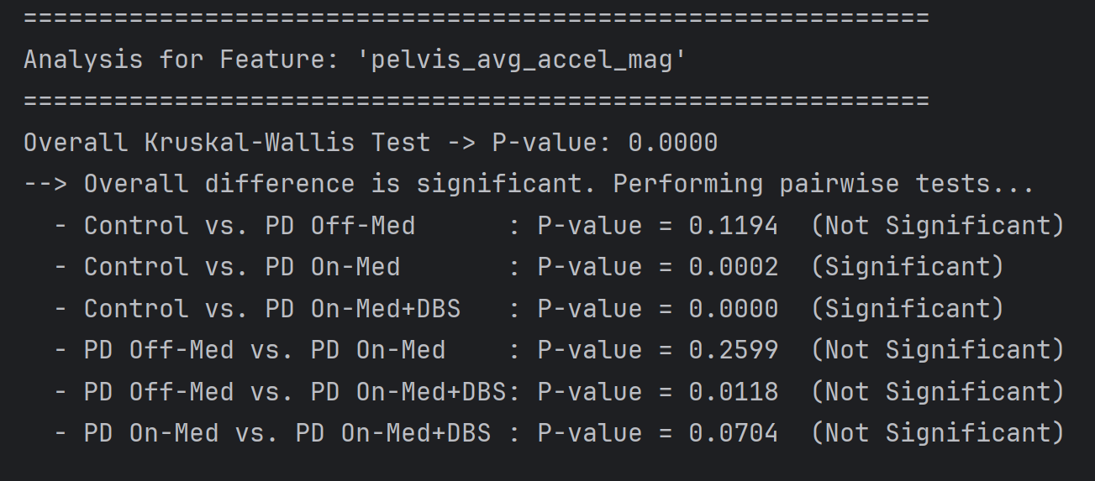
Statistically Significant Results: ‘pelvis_avg_accel_mag’
Interpretation:
Control vs. PD On-Med and Control vs. PD On-Med+DBS are significantly different, suggesting pelvis_avg_accel_mag can distinguish between healthy controls and treated PD patients.
No significant differences were found between Parkinson's subgroups, even after medication or DBS, implying limited sensitivity of this feature to treatment conditions.
pelvis_avg_accel_mag stands for:
Average acceleration magnitude at the pelvis during a movement or activity.

Slide 9

Statistically Significant Results: ‘pelvis_avg_jerk_mag’
Jerk is the derivative of acceleration (i.e., how quickly acceleration is changing).
pelvis_avg_jerk_mag is the average magnitude of jerk at the pelvis over time.
Interpretation:
There are significant differences between the Control group and both PD On-Med and PD On-Med+DBS.
However, there are no significant differences between Parkinson’s subgroups, suggesting that pelvis_avg_jerk_mag may be more effective at distinguishing PD vs. healthy controls than differentiating treatment conditions within PD.

Slide 10
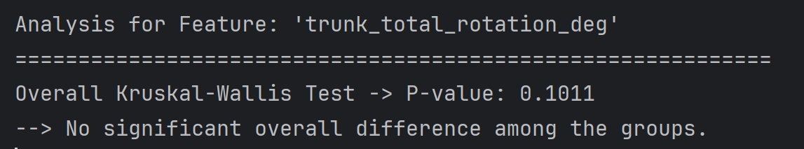
Statistically Significant Results: ‘trunk_total_rotation_deg’
trunk_total_rotation_deg : total trunk rotation in degrees

Slide 11
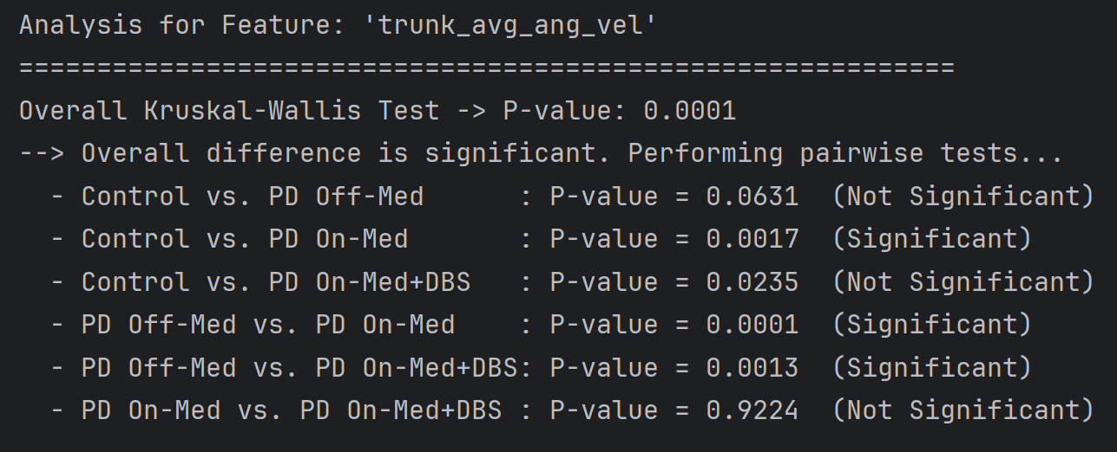
Statistically Significant Results: ‘trunk_avg_ang_vel ’
Interpretation:
Control vs. PD On-Med shows a significant difference, suggesting that medication influences trunk movement velocity.
PD Off-Med significantly differs from both PD On-Med and PD On-Med+DBS, indicating treatment effects (either medication or DBS) impact trunk angular velocity.
No significant difference between PD On-Med and PD On-Med+DBS, implying similar effects from both treatment types in this metric.
Control vs. PD Off-Med is close to significant (p = 0.0631), but doesn’t pass the corrected threshold.
The feature trunk_avg_ang_vel refers to the average angular velocity of the trunk, which reflects how quickly the torso rotates or moves during a task (measured in degrees/second or radians/second).

Slide 12
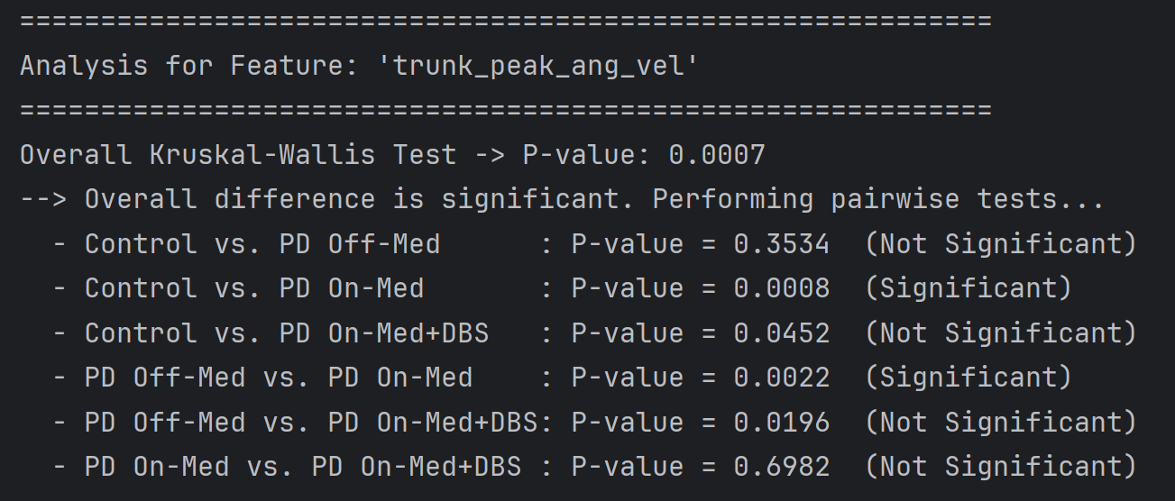
Statistically Significant Results: ‘trunk_peak_ang_vel ’
Interpretation:
Control vs. PD On-Med and PD Off-Med vs. PD On-Med are statistically significant. This suggests that medication has a measurable effect on the peak angular velocity of the trunk.
However, no significant differences were observed between Control and PD Off-Med, or between On-Med and DBS, indicating that:
Trunk peak angular velocity may not differentiate untreated PD from healthy individuals.
DBS and medication may produce similar effects on this feature.
The feature trunk_peak_ang_vel represents the peak (maximum) angular velocity of the trunk — how fast the trunk rotated at its highest speed during movement.

Slide 13
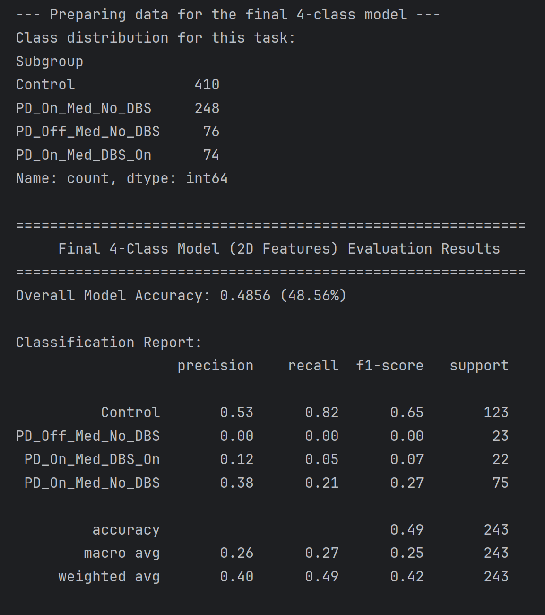
Model Summary: Final 4-Class Random Forest (2D Features)
Setup:
Target classes (Subgroups):
Control: 410
PD_On_Med_No_DBS: 248
PD_Off_Med_No_DBS: 76
PD_On_Med_DBS_On: 74
Features used (8 kinematic variables):
duration_sec, pelvis_path_length, pelvis_peak_speed,
pelvis_avg_accel_mag, pelvis_avg_jerk_mag,
trunk_total_rotation_deg, trunk_avg_ang_vel, trunk_peak_ang_vel
Model: RandomForestClassifier with class_weight='balanced'
Train/Test split: 70/30 with stratification
Scaler: StandardScaler

Slide 14
Model Summary: Final 4-Class Random Forest (2D Features)
Interpretation
Strengths:
The model performs best on the Control group (F1 = 0.65), likely due to higher class size and clearer feature separation.
Basic treatment condition (On medication, no DBS) has some recognition (F1 = 0.27).
Weaknesses:
Model fails to distinguish between the two smaller PD subgroups:
PD_Off_Med_No_DBS and PD_On_Med_DBS_On both have near-zero F1-scores.
This is likely due to:
Class imbalance (410 vs 74/76)
Overlapping features (2D kinematics may not be expressive enough for subtle PD treatment effects)
Possibly too few samples in smaller subgroups for reliable learning

Slide 15
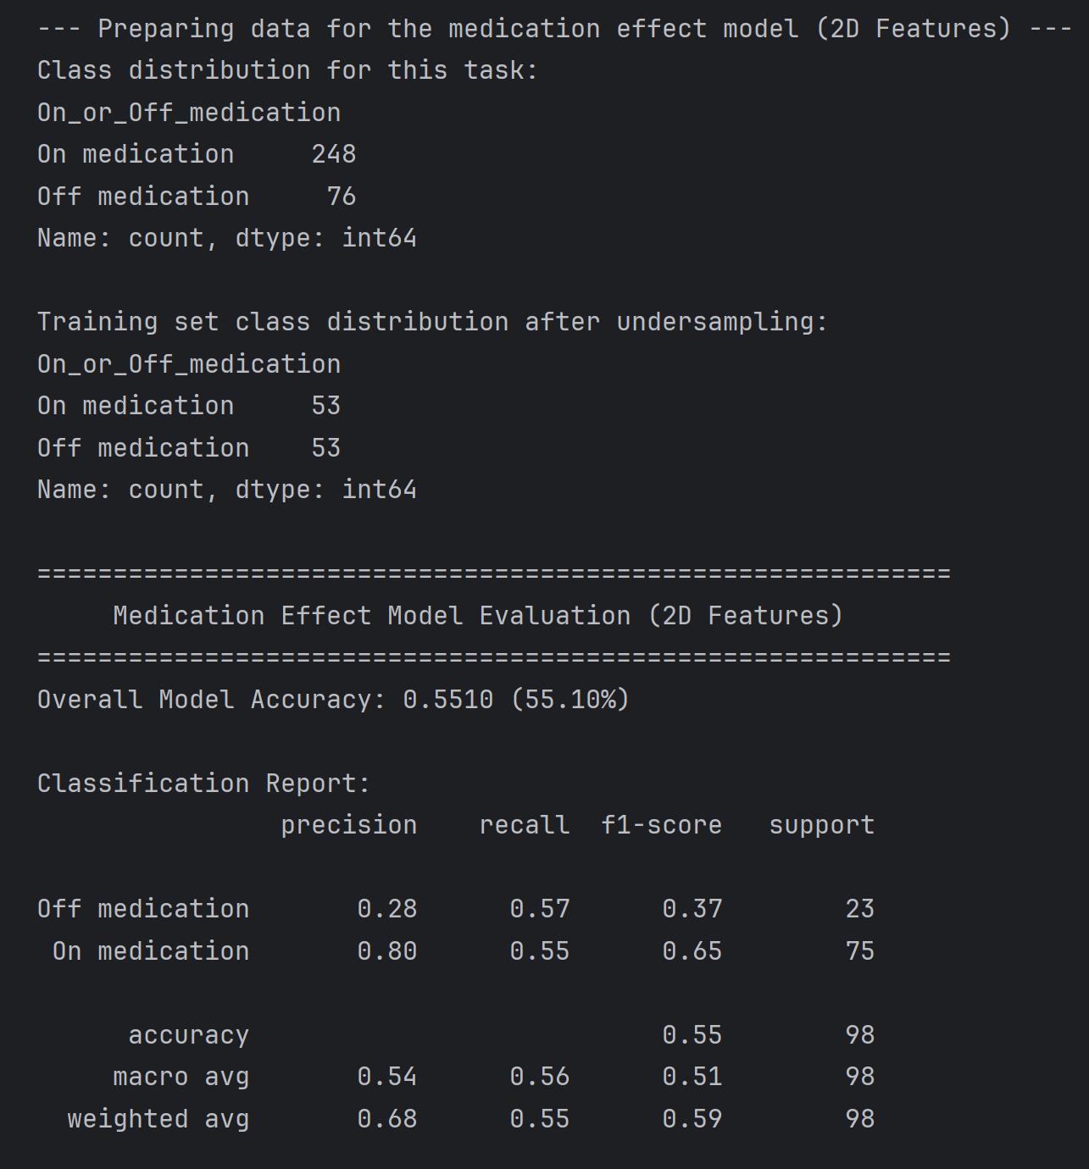
Binary Model: PD On-Med vs. PD Off-Med (No DBS) using 2D Features
Setup:
Classes:
On medication (248 samples)
Off medication (76 samples)
Turn type: pivot_turn at 90_degrees
Undersampling: Training set balanced to 53 samples per class
Features used: 2D feature
The classifier struggles to confidently identify Off-Med patients

Slide 16
Feature work
In this binary classification task, we used a subset of 8 kinematic 2D features. While the model achieved moderate performance, the limited feature set may not fully capture the subtle movement differences between the On-medication and Off-medication states.
To improve classification performance, it would be valuable to experiment with a broader set of 2D features, such as pelvis_displacement, pelvis_avg_speed, or bounding box metrics like bbox_width, bbox_area, etc., as originally available.
Interestingly, this aligns with our Kruskal-Wallis statistical tests, where many pairwise comparisons between the On-med and Off-med groups were not statistically significant. This suggests that the underlying kinematic differences between the two medication states may be limited or subtle, making both classification and statistical separation challenging — and emphasizing the need for more sensitive or high-dimensional features.
Additionally, in this analysis we only considered data from 90-degree pivot turns, which represents just a portion of the full dataset. The dataset also includes many other combinations of turning types and angles (e.g., 135°, 180°, step turns), which were excluded here. Incorporating diverse turn types and angles in future models may enrich the movement patterns and improve classification performance.

